Slide 1
Chapter 11: Phasors and Complex Numbers (Part 1)
Phasors

Slide 2
Objectives
After completing Part 1 of this chapter, you should be able to :
Understand how a phasor can be used to represent a sine wave.
Draw a phasor diagram to represent a sine wave.
Draw a phasor diagram to show the relative relationship between 2 or more sine waves.
Write the angular and time domain expressions of a sine wave.

Slide 3
11-1 Introduction
A phasor is a vector with a constant magnitude that rotates at a constant angular velocity.
Phasors are useful in :
• providing a graphic means for representing sine waves in terms of their magnitude and phase angle
• for analysis of ac circuits with sinusoidal sources.

Slide 4
Introduction
Phasor diagrams
→ abstract method of representing quantities that have both a magnitude & a direction
In Sinusoidal voltages and currents,
magnitude = amplitude
direction = phase angle
Hence AC waveforms can be represented using Phasor diagrams

Slide 5
Phasor Diagrams
90º
Length of the phasor "arrow" → magnitude of a sinusoidal quantity
Angle, θ, → angular position (a positive angle in this example)
Magnitude
θ
180º
0º
270º
90º
2
Phasor :
magnitude = 2
phase angle = 45º
45º
180º
0º
270º

Slide 6
Phasor Diagrams
90º
Phasor
magnitude = 3
phase angle = 180º
180º
3
0º
270º
90º
Phasor
magnitude = 1
phase angle = -45º
or +315º
180º
0º
-45º
1
270º

Slide 7
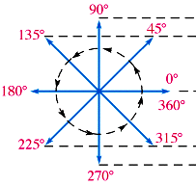
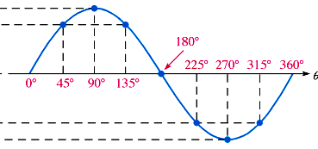
Phasor Representation of a Sine wave
Full cycle of a sine wave → represented by rotation of a phasor through 360º
Instantaneous value of sine wave at any point = vertical distance from the tip of phasor to the horizontal axis
Notes:
08/22/99
1

Slide 8
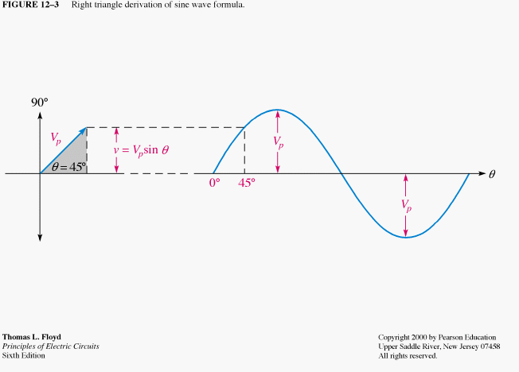
Phasors and the Sine wave Formula
Voltage phasor at angular position of 45º and corresponding point on sine wave
Instantaneous value of sine wave is related to both position and length of phasor
Vertical distance from phasor tip down to horizontal axis represents instantaneous value of sine wave at that point
Notes:
08/22/99
1

Slide 9
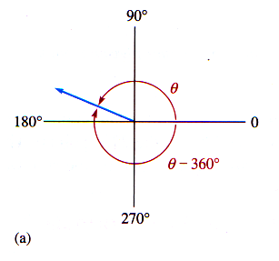
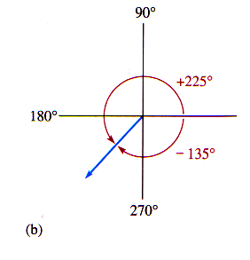
Positive and Negative Phasor Angles
Position of a phasor at any instant can be expressed as a positive angle or as an equivalent negative angle
Positive angles → counter-clockwise from 0º
Negative angles → clockwise from 0º
Notes:
08/22/99
2

Slide 10
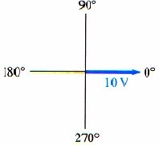
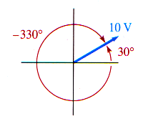
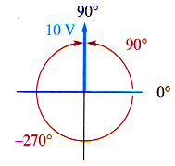
Example 11-1
For each phasor, determine the instantaneous voltage.

Slide 11
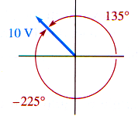
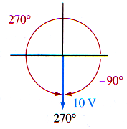
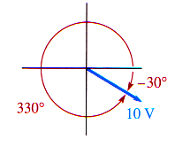
Example 11-1 (cont’d)
Determine instantaneous sine wave value.

Slide 12
Related Problem
If a phasor is at 30º and its length represents 24 V (peak), what is the instantaneous value of the sinusoidal voltage?
Solution
v = V_{P} sin θ = 24 sin 30º = 24 x 0.5 = 12 V

Slide 13
Phasor Diagrams for Multiple Sine Waves
A phasor diagram may be used to show the relative relationship between 2 or more sine waves of same frequency
A phasor in a fixed position represents a complete sine wave
Phase angle between two or more sine waves of same frequency remains constant throughout cycles

Slide 14
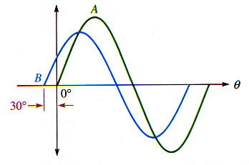
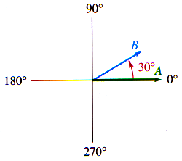
These two sine
waves can
represented by
a phasor diagram
Wave B leads Wave A by 30º
It has smaller amplitude than Wave A
This is indicated by lengths of phasors

Slide 15
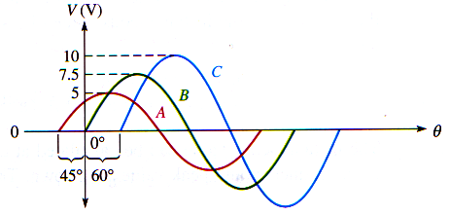
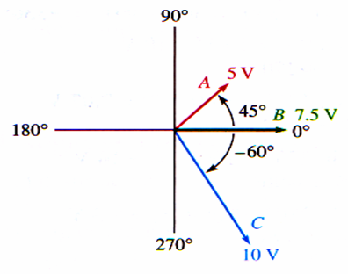
Example 11-2:
Use a phasor diagram to
represent the 3 sine waves
Phasor diagram
representing the 3 sine waves

Slide 16
Angular Velocity of a Phasor
One cycle of a sine wave is traced out when a phasor is rotated through 2π radians (360º)
Time required to go through 2π radians is the period (T) of the sine wave.
The velocity of rotation of the phasor is the angular velocity and is designated ω.
The frequency is related to the angular velocity of the phasor by :

Slide 17
The angle θ through which the phasor has rotated at any instant of time t is given by :
θ = ωt = 2π ft
Equation for instantaneous value of a sinusoidal voltage can be written as :
v(θ) = V_{p} sin θ (angular domain expression)
or
v(t) = V_{p} sin2π ft (time domain expression)
Instantaneous value can be calculated at any point in time if the frequency and peak value are known

Slide 18
Additional Example (not in textbook)
Write the time domain sinusoidal expression for each phasor.
The voltages indicated in the phasor diagram are peak voltages and the phasors have a frequency of 1 kHz.
Solution :
The time domain sinusoidal expression is given by :
v(t) = Vp sin(2πft + φ) V
v_{A} = 5 sin [(2π x 1000 x t) + 45º] = 5 sin (2000πt + 45º) V
v_{B} = 7.5 sin [(2π x 1000 x t) + 0º] = 7.5 sin (2000πt) V
v_{C} = 10 sin [(2π x 1000 x t) - 60º] = 10 sin (2000πt - 60º) V

Slide 19
Important Note
In the preceding examples, the magnitudes of the phasors are expressed in peak values of the sinusoidal ac voltages.
However, sinusoidal AC waves are usually defined by the RMS values of the ac voltages and currents.
Thus, magnitudes of phasors may also be expressed in RMS values.
In AC circuit analysis, the magnitude portion of a phasor will be taken to represent the RMS Value of an AC voltage or current unless otherwise specified

Slide 20
Summary
A phasor diagram can be drawn to represent a sine wave.
The angular position of the phasor represents angle of sine wave with respect to a reference, and length of a phasor represents the amplitude.
A phasor diagram can also be used to show the phase relationship between 2 or more sinusoidal quantities.
The time domain sinusoidal expression is given by v(t) = Vp sin(2πft + Φ) V

Slide 21
End of Chapter 11 (Part 1)

